Slide 1
Physical Properties of Metals and Non-Metals

Slide 2

By the end of this lesson, you should be able to:
Describe the physical properties of metals and non-metals.
Identify whether a substance is a metal or a non-metal, based on its physical properties.

Slide 3
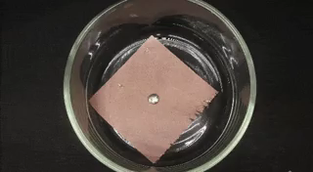
We can categorise and identify substances based on their physical properties.
Elements can be broadly categorised as metals or non-metals. Metals and non-metals have different physical properties!
This means that we can use the physical properties of a substance to identify it as either a metal or a non-metal.

Slide 4
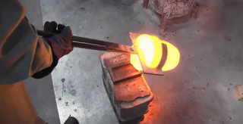
Mercury is the only metal that is not solid at room temperature (it is a liquid).
Aside from mercury, all metals are solid at room temperature. This is because metals generally have high melting and boiling points. For example, gold has a boiling point of 2970∘C.
All non-metallic elements (aside from bromine) are either solids or gases at room temperature, which also tells us that the melting and boiling points of non-metals are very variable.

Slide 5

Metals are lustrous, while non-metals are dull.
Metallic elements appear shiny and luminous, due to light being reflected off their surfaces. Metals like gold, silver and platinum are used to make jewellery as they can be polished to appear even more lustrous.
Non-metallic elements do not reflect light like metals, so they appear dull and non-lustrous.

Slide 6

Metals are both malleable and ductile, whereas non-metals are neither.
Metals are generally able to be drawn into long, thin wires and hammered into thin sheets without breaking.
Non-metallic elements are brittle, which means they break before they can be pressed into sheets or drawn into wire.

Slide 7


Metals are good conductors of heat and electricity, whereas non-metals are poor conductors of both.
Metals, especially copper, conduct both heat and electrical current very well.
Non-metals are poor conductors of both heat and electricity.

Slide 8
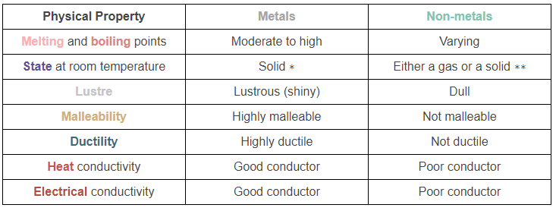
Metals and non-metals physical properties summary:

